Slide 1
Tvandchill
By jeffrey batista and BRITTANY HOBAN

Slide 2
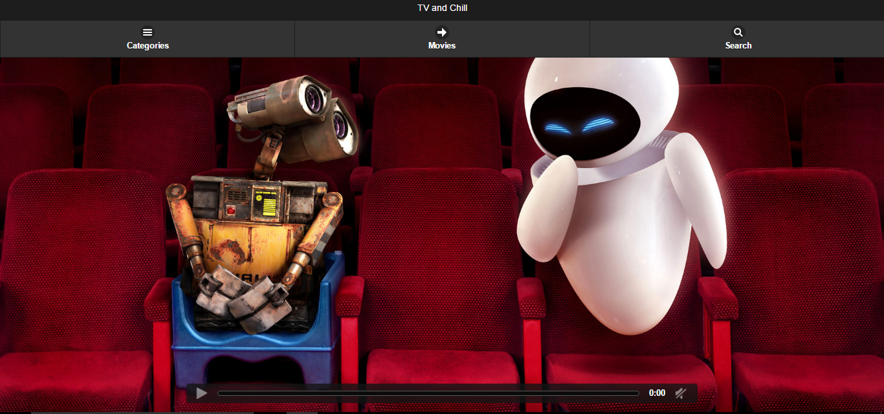
The home page

Slide 3
Purposes of the app
It allows users to watch hundreds of live channels
Allow users to watch movies without having to download them
None of the content is hosted on the site
Fully anonymous

Slide 4
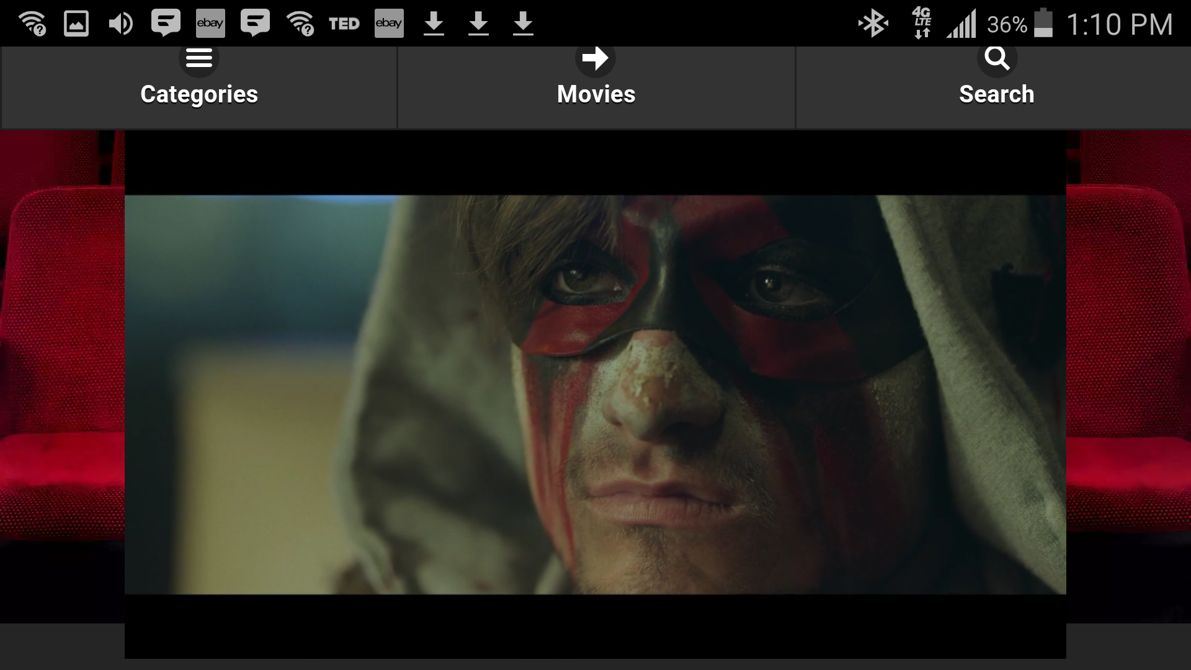
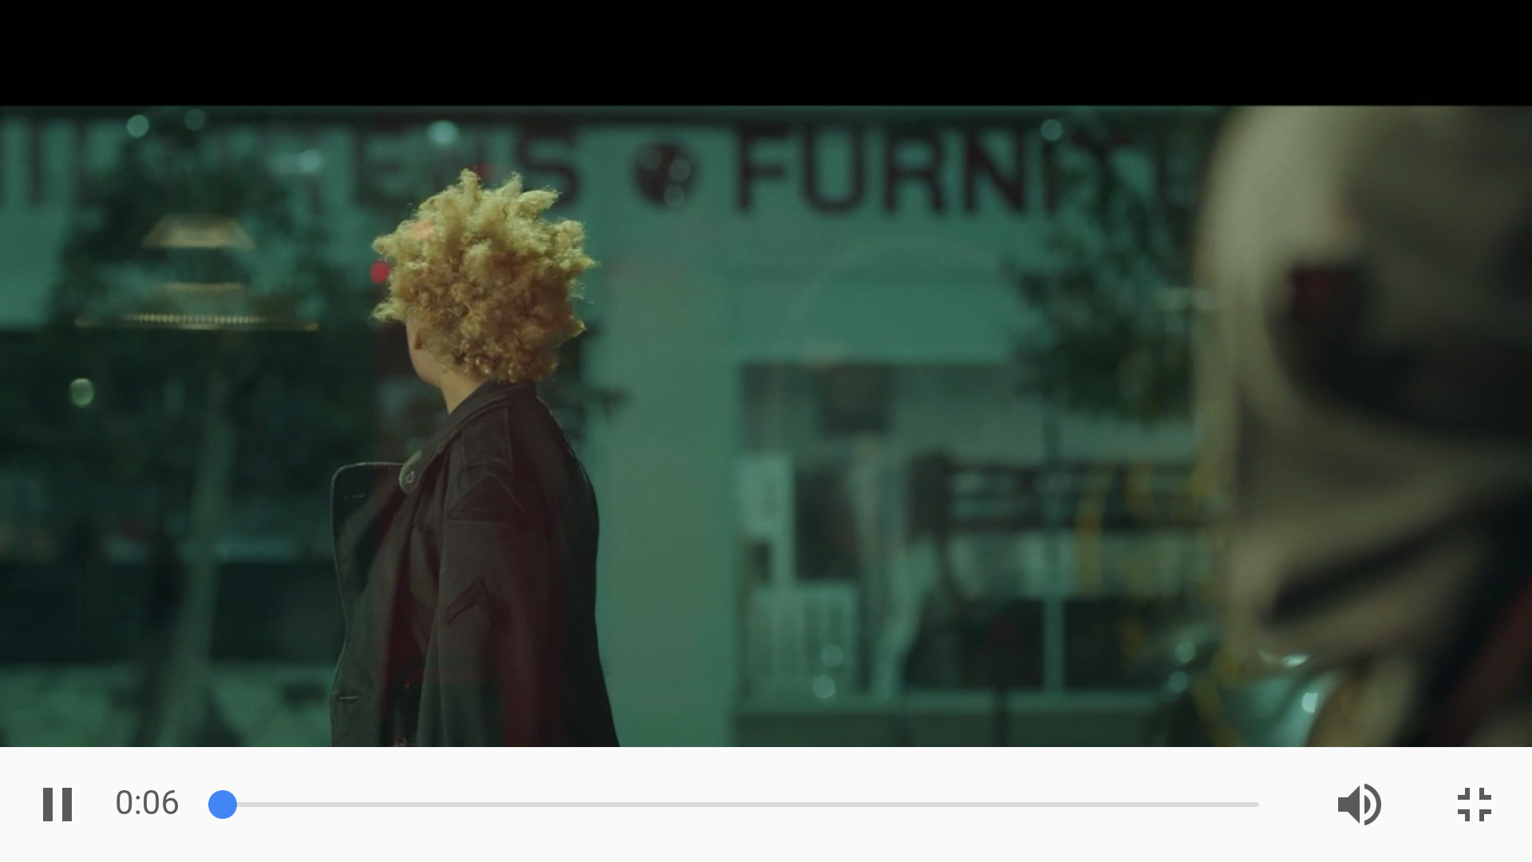
The UI on mobile

Slide 5
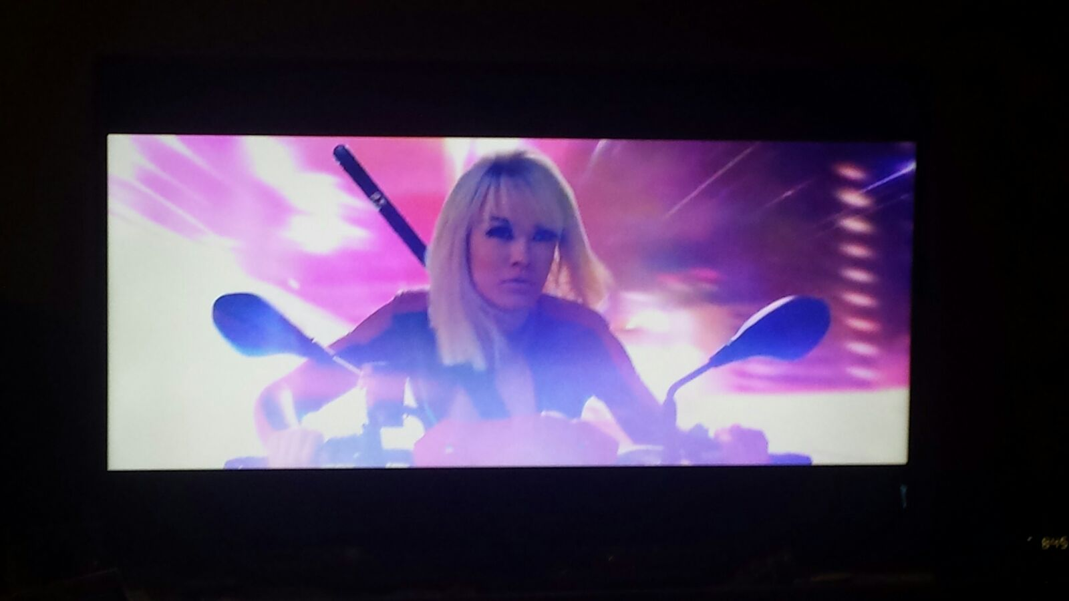
UI on smart TV

Slide 6
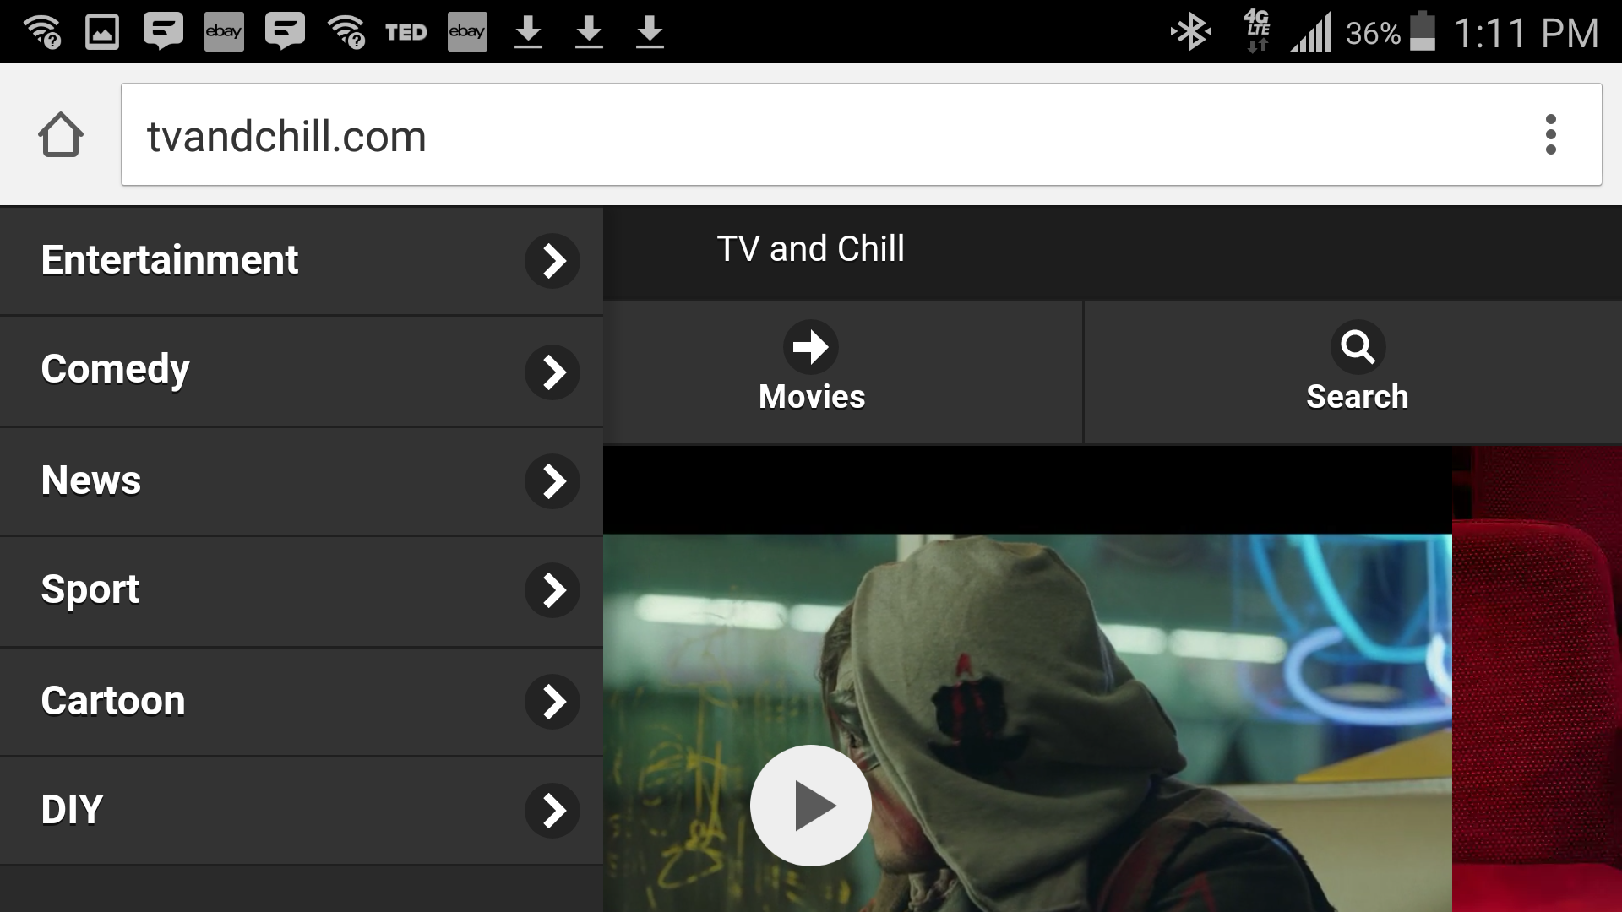
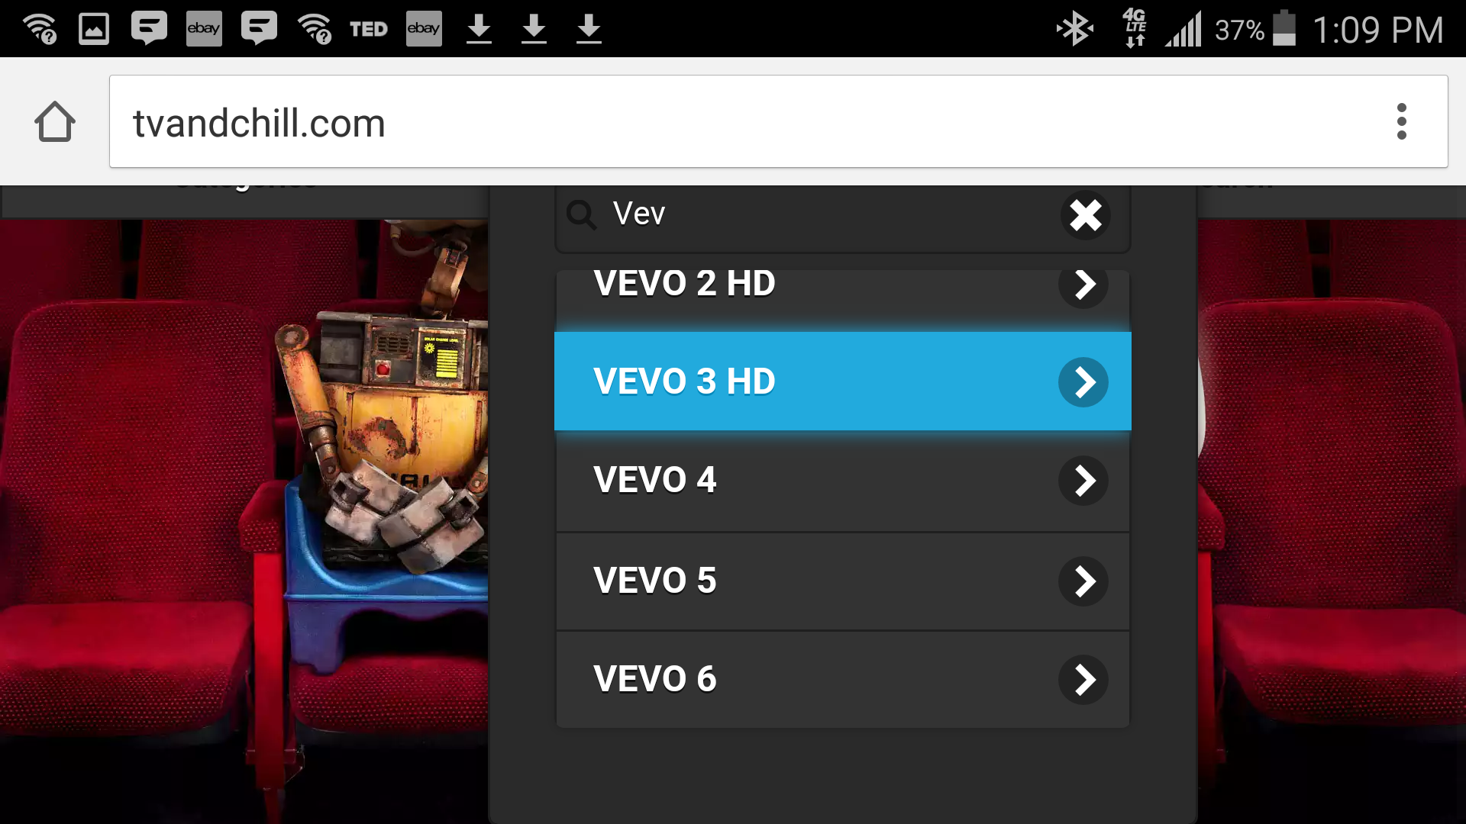
Ui ON MOBILE

Slide 7
TV and chill was create with
Javascript- Backbone.Js, Jquery
Bootstrap
Python
Underscore Templating

Slide 8
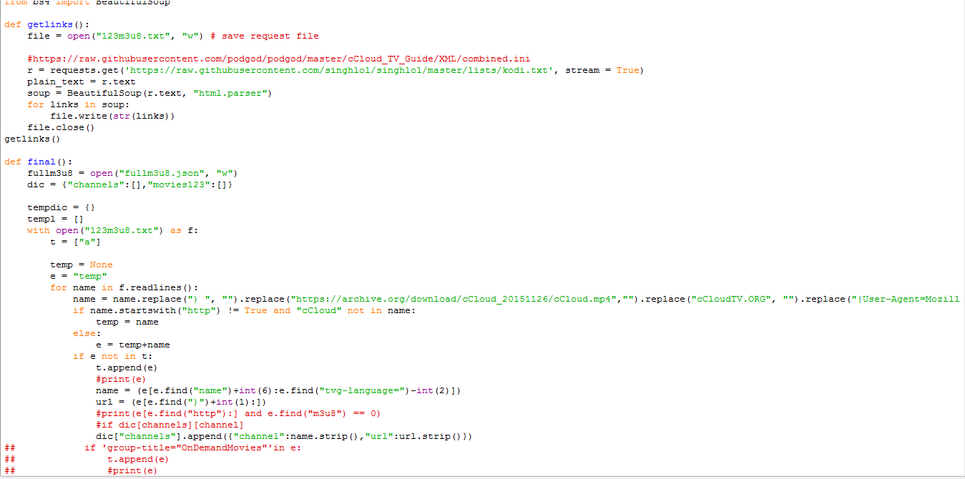
Back End Snippet

Slide 9
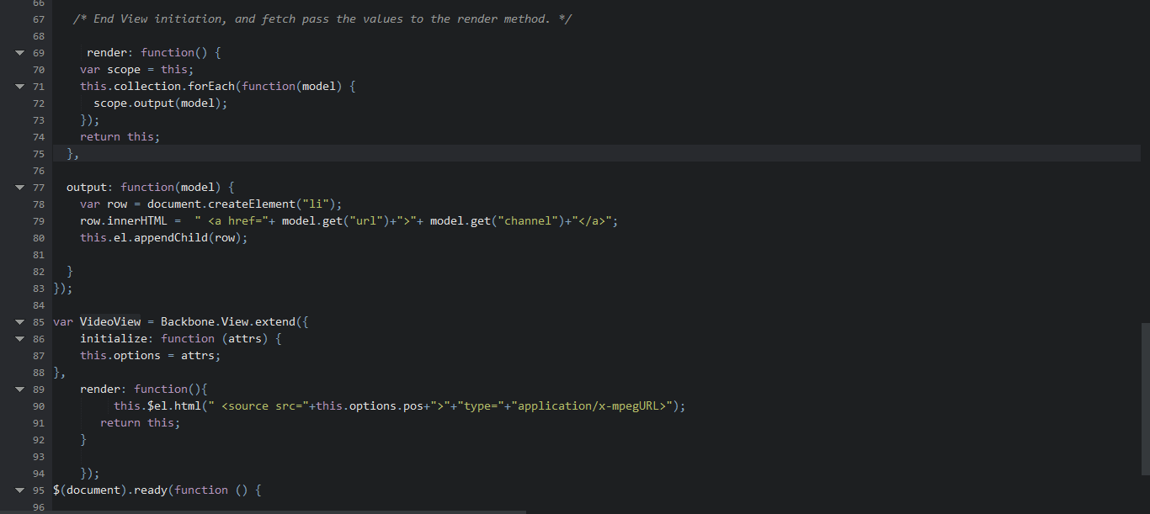
Front End Snippet

